Slide 1
Knowledge Discovery
November 2010
Mark Guiton
Director, Government Programs
mguiton@cray.com

Slide 2
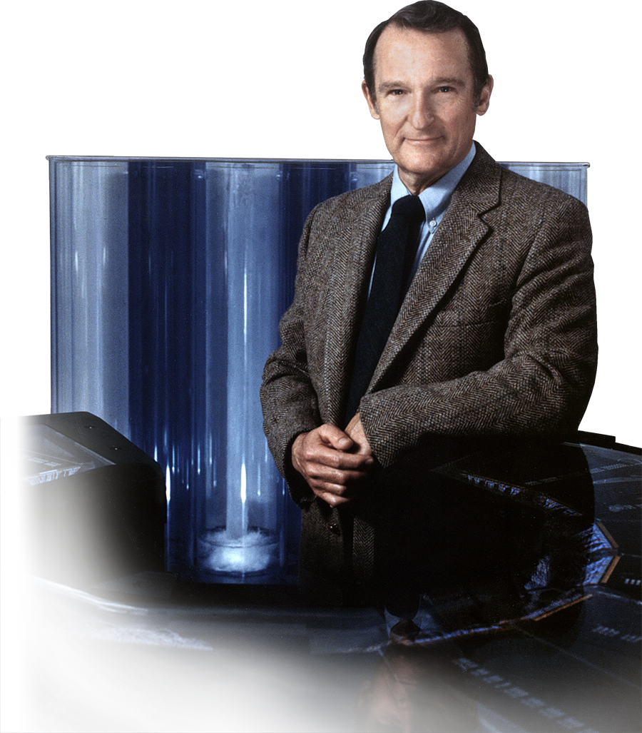
Cray Today…
Seymour Cray
  The father of supercomputing
  Founded Cray Research in 1972
Cray Inc. formed in 2000
  A derivative of Cray Research
  Nasdaq: CRAY
  875 employees worldwide
  Headquarters in Seattle, WA
  Major facilities in WI, MN & TX
Supercomputing Leadership
  #1 Supercomputer in the world
  Technology leader
  Market leader
Knowledge Discovery
  Focused on performance and scalability for data intensive problems

Slide 3

























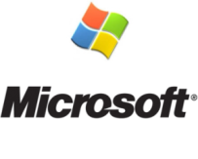






Cray Customer Base
Unmatched performance
Production Reliability
Power/cooling efficient
Adaptive Supercomputing

Slide 4
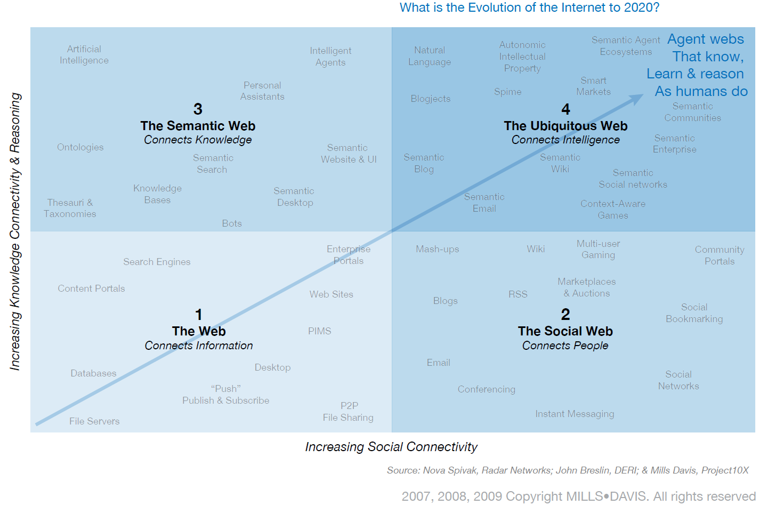
Web 3.0: Next Generation IT

Slide 5
Web 3.0: Next Generation IT
Characteristics
Encodes meaning separately from data & application code
  Data Integration →Can provide a comprehensive (virtual) view of your data, by connecting data, content & processes across internal data silos & the external world
    Facilitates an abstraction (virtual) layer above existing IT infrastructure
  Automated Reasoning →Can enable machines & people to understand, share & reason with data at runtime
  Highly Adaptable to Change → Can add, change and implement new relationships in data faster, easier and cheaper
    Accommodates most change as easy as inputting data
  Interactive Analytics → Can directly search topics, concepts and associations that span a vast number of sources in real-time
  Richer, more intelligent Analysis →Can foster deeper, more complex analysis, extracting better knowledge from greater amounts of external with internal data, to:
      Test new ideas, do more what-if analyses
      Assess strategies and risks
      Add relationship and correlational capability to today’s statistical focused business intelligence
      Make business intelligence friendlier and more natural to decision makers
Uses standardized technologies (created by the World Wide Web Consortium)
  Resource Description Framework (RDF)
  Web Ontology Language (OWL)
  SPARQL Protocol and RDF Query Language (SPARQL)
  Open Source Orientation

Slide 6
Web 3.0: Next Generation IT
Relational Database Semantic Knowledgebase
Customer Table
Cust-ID | Name | City
394021-1454 | Cathy | Seattle
subject
predicate
object
Cathy
purchased
iPad
Purchased Items Table
Purchase-ID | Cust-ID | Item
P942-4294 | 394021-1454 | iPad
purchased
Cathy
iPad
…
…
…
…
…

Slide 7
Web 3.0: Next Generation IT
Characteristics
Encodes meaning separately from data & application code
  Data Integration →Can provide a comprehensive (virtual) view of your data, by connecting data, content & processes across internal data silos & the external world
    Facilitates an abstraction (virtual) layer above existing IT infrastructure
  Automated Reasoning →Can enable machines & people to understand, share & reason with data at runtime
  Highly Adaptable to Change → Can add, change and implement new relationships in data faster, easier and cheaper
    Accommodates most change as easy as inputting data
  Interactive Analytics → Can directly search topics, concepts and associations that span a vast number of sources in real-time
  Richer, more intelligent Analysis →Can foster deeper, more complex analysis, extracting better knowledge from greater amounts of external with internal data, to:
      Test new ideas, do more what-if analyses
      Assess strategies and risks
      Add relationship and correlational capability to today’s statistical focused business intelligence
      Make business intelligence friendlier and more natural to decision makers
Uses standardized technologies (created by the World Wide Web Consortium)
  Resource Description Framework (RDF)
  Web Ontology Language (OWL)
  SPARQL Protocol and RDF Query Language (SPARQL)
  Open Source Orientation

Slide 8
Web 3.0: Next Generation IT
Typical
Enterprise
Major Business IT Pain Point
Gain better access to the available data you need to make better business decisions
Data Silos
(Structured, semi-structured,
unstructured data -> e.g. Oracle,
Sybase, MySQL, email, etc.)

Slide 9
Web 3.0: Next Generation IT
Typical
Enterprise
RDF Data Stores
(Heterogeneous data converted
to standardized RDF)
Data Silos
(Structured, semi-structured,
unstructured data -> e.g. Oracle,
Sybase, MySQL, email, etc.)

Slide 10
Web 3.0: Next Generation IT
Typical
Enterprise
Query Processing
Requires complex large scale
graph queries
Cray XMT
Integrated
Enterprise
Data
RDF Data Stores
(Heterogeneous data converted
to standardized RDF)
Data Silos
(Structured, semi-structured,
unstructured data -> e.g. Oracle,
Sybase, MySQL, email, etc.)

Slide 11
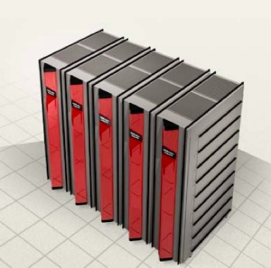
Cray Offering
Background
  With DoD support, Cray developed the eXtreme MultiThreading (XMT) system and technology to solve intelligence processing problems (e.g. “connecting the dots” in large databases of information about people, places, organizations, events, and the relationships between them)
Characteristics
  Very large shared memory
    32TB or more
  Extreme multithreading
    128 hardware threads per processor
    Practically unlimited virtual threads
  Very low power
    30 watt processors
  Ease of use
  Superior price/performance
  Excels at Data Intensive Computing
    E.g. Graph Analytics, “Connecting the Dots”
Formed Partnerships with Web 3.0 Software Companies
  Provide complete solutions to customers desiring next generation IT capability

Slide 12
Web 3.0: Next Generation IT
Typical
Enterprise
Query Processing
Requires complex large scale
graph queries
Cray XMT
Integrated
Enterprise
Data
RDF Data Stores
(Heterogeneous data converted
to standardized RDF)
Data Silos
(Structured, semi-structured,
unstructured data -> e.g. Oracle,
Sybase, MySQL, email, etc.)

Slide 13
Web 3.0: Next Generation IT
Reasoning
Customer Table
Cust-ID | Name | Son
394021-1454 | John Adams | Mike Adams
394021-1454 | John Adams | Paul Adams
Existing Database Fact 1: John has a son named Mike
Existing Database Fact 2: John has a son named Paul
New Inferred Fact: Mike and Paul are brothers
Semantic Technology is far better at reasoning than traditional IT

Slide 14
Web 3.0: Next Generation IT
Advanced Reasoning
Automating the identification of illicit activity
Identifying compliance red flags within enormous amounts of business process data
Finding inconsistencies in scientific results even across multiple fields of study
Improve communication and collaboration

Slide 15
Web 3.0: Next Generation IT
Typical
Enterprise
Integrated
Data
RDF Data Stores
(Heterogeneous data converted
to standardized RDF)
Data Silos
(Structured, semi-structured,
unstructured data -> e.g. Oracle,
Sybase, MySQL, email, etc.)

Slide 16
Web 3.0: Next Generation IT
Typical
Enterprise
Reasoning
Semantic technology
reasoning creates even
bigger graphs requiring
more powerful computing
Cray XMT
Integrated
Data
RDF Data Stores
(Heterogeneous data converted
to standardized RDF)
Data Silos
(Structured, semi-structured,
unstructured data -> e.g. Oracle,
Sybase, MySQL, email, etc.)

Slide 17

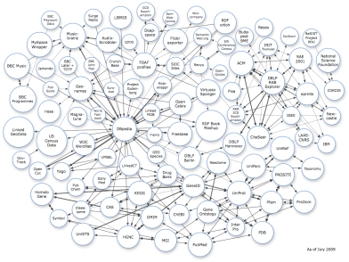
Web 3.0: Next Generation IT
Typical
Enterprise
Integrated
Data
Linked Graphs
Worldwide
(Standardized RDF Data Stores)
RDF Data Stores
(Heterogeneous data converted
to standardized RDF)
Data Silos
(Structured, semi-structured,
unstructured data -> e.g. Oracle,
Sybase, MySQL, email, etc.)

Slide 18
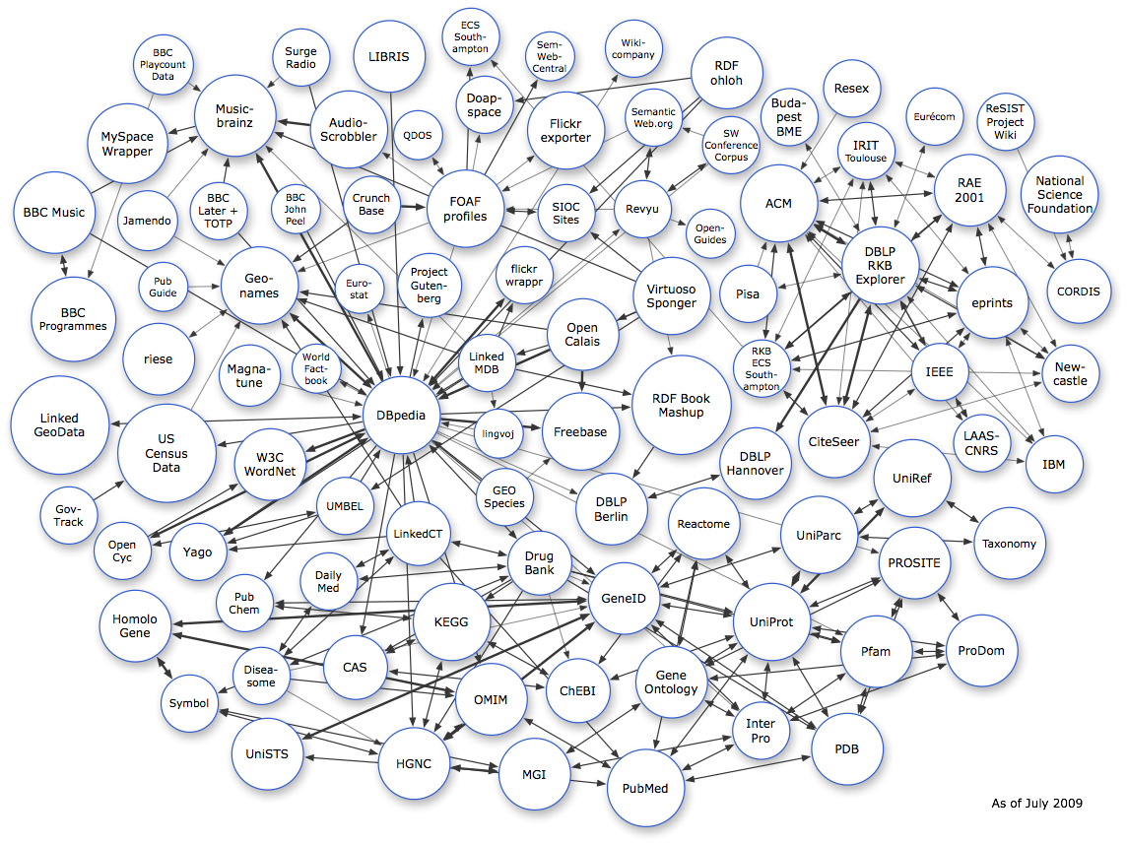
Notes:
4.7 billion RDF triples, which are interlinked by around 142 million RDF links

Slide 19
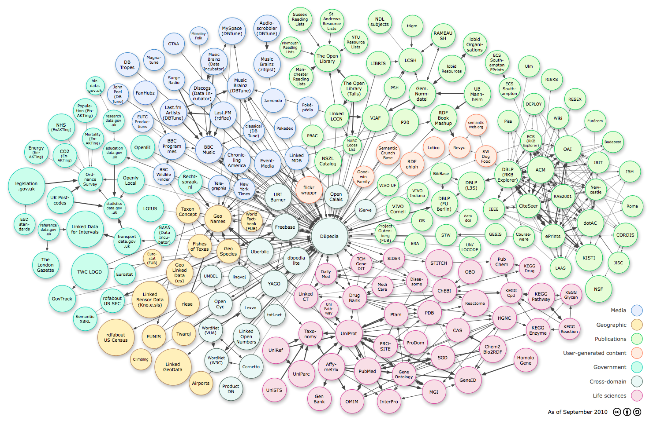

Slide 20
Web 3.0: Next Generation IT
Typical
Enterprise
Graphs
link together billions of data facts
RDF Data Stores
(Heterogeneous data converted
to standardized RDF)
Data Silos
(Structured, semi-structured,
unstructured data -> e.g. Oracle,
Sybase, MySQL, email, etc.)

Slide 21
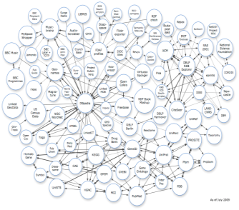
Web 3.0: Next Generation IT
Typical
Enterprise
Enterprise+World Data
Far richer
Querying and reasoning
becomes much more
powerful
Graph grows even larger
Cray XMT
RDF Data Stores
(Heterogeneous data converted
to standardized RDF)
Data Silos
(Structured, semi-structured,
unstructured data -> e.g. Oracle,
Sybase, MySQL, email, etc.)

Slide 22





Web 3.0 Semantic → Disruptive Technology
Company 5

Slide 23
Web 3.0: Next Generation IT
High Profile Use Cases
Data.gov – US Government’s effort to make public data more transparent and open
  White House Directive
Data.gov.uk – UK Government’s effort to make its public data more transparent and open
  Openpsi.org
Office of the Secretary of Defense
Fortune 500 companies

Slide 24
IT Prognosticators
IT Trends
Gartner Identifies the Top 10 Strategic Technologies for 2010
  The top 10 strategic technologies for 2010 include:
  Advanced Analytics. Optimization and simulation is using analytical tools and models to maximize business process and decision effectiveness by examining alternative outcomes and scenarios, before, during and after process implementation and execution. This can be viewed as a third step in supporting operational business decisions. Fixed rules and prepared policies gave way to more informed decisions powered by the right information delivered at the right time, whether through customer relationship management (CRM) or enterprise resource planning (ERP) or other applications. The new step is to provide simulation, prediction, optimization and other analytics, not simply information, to empower even more decision flexibility at the time and place of every business process action. The new step looks into the future, predicting what can or will happen.
  Social Computing. Workers do not want two distinct environments to support their work – one for their own work products (whether personal or group) and another for accessing “external” information. Enterprises must focus both on use of social software and social media in the enterprise and participation and integration with externally facing enterprise-sponsored and public communities. Do not ignore the role of the social profile to bring communities together.
IDC’s Top 10 predictions for 2010
  Business Application Transformation. Workers“Business applications will undergo a fundamental transformation – fusing business applications with social/collaboration software and analytics into a new generation of ‘socialytic’ apps, challenging current market leaders.”

Slide 25
Web 3.0: Next Generation IT
Semantic Web Technology Has Broad Applicability
Data Warehousing
Database
Business Intelligence
Advanced Analytics
Web Search
Social Networking
Master Data Management
Web 3.0 Applications
Enterprise Resource Planning
Information Access
Federated DB Management

Slide 26
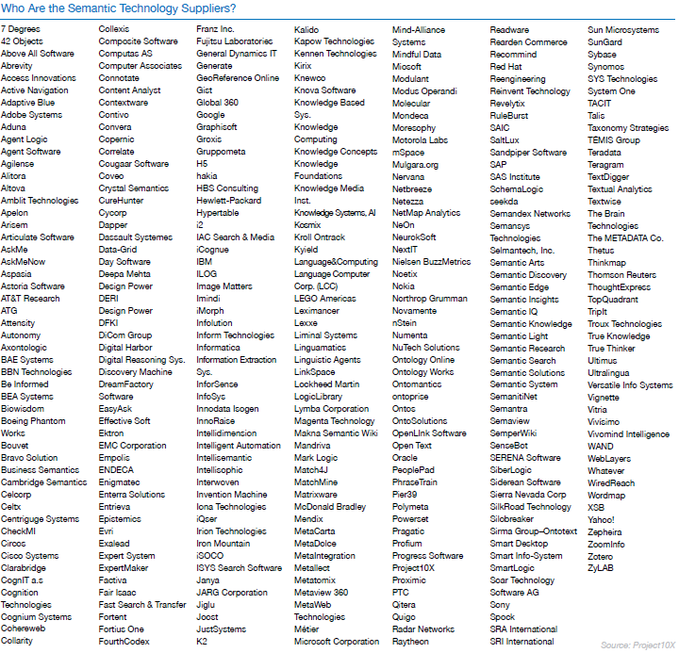
270 Companies

Slide 27
Web 3.0: Next Generation IT
Semantic Technology Knowledgebase Product
Query
Query
Query
Response
Response
Response
World Wide Web or
Secure Outside Data

Slide 28
Knowledge Discovery
Traditional IT vs. Web 3.0 Technology
Issue | Traditional IT | Semantic Next Gen Technology
Set up | Huge initial effort - meaning and relationships must be redefined and “hard wired” into data formats and application code at design time | Moderate initial effort - can be built on top of existing IT
Maintenance | Large maintenance effort - requires manual human intervention to make changes to data sources or business logic | Small maintenance effort - Accommodates most change as easy as inputting data
Data Analysis | Statistical analysis of mainly numeric data is the focus | Easier, more in-depth data exploration - Excellent at identifying relationships & correlations not previously identifiable
Structured, semi-structured and unstructured data | Limited ability to extract knowledge from heterogeneous data | Easy data integration enhances the ability to extract knowledge from varied data sources
Data and System Integration | Complexity grows fast when adding data sources – mapping new data sources to services and conforming to centralized control is a huge effort | Data integration is quick and seamless - More efficient, faster and cheaper - New data sources can be used easily without the need for centralized control
Scalability | The hardware controls the type of queries that can be asked | Flexible querying against multi-schema datasets can be done naturally

Slide 29
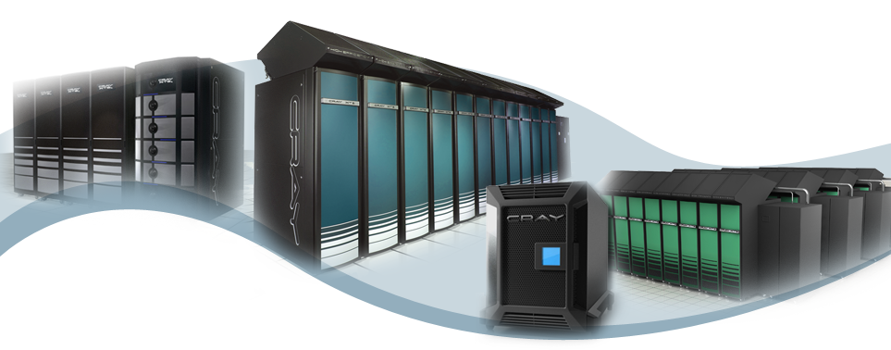
Thank You!
Questions?
Notes:
Cray Proprietary
29

